Slide 1


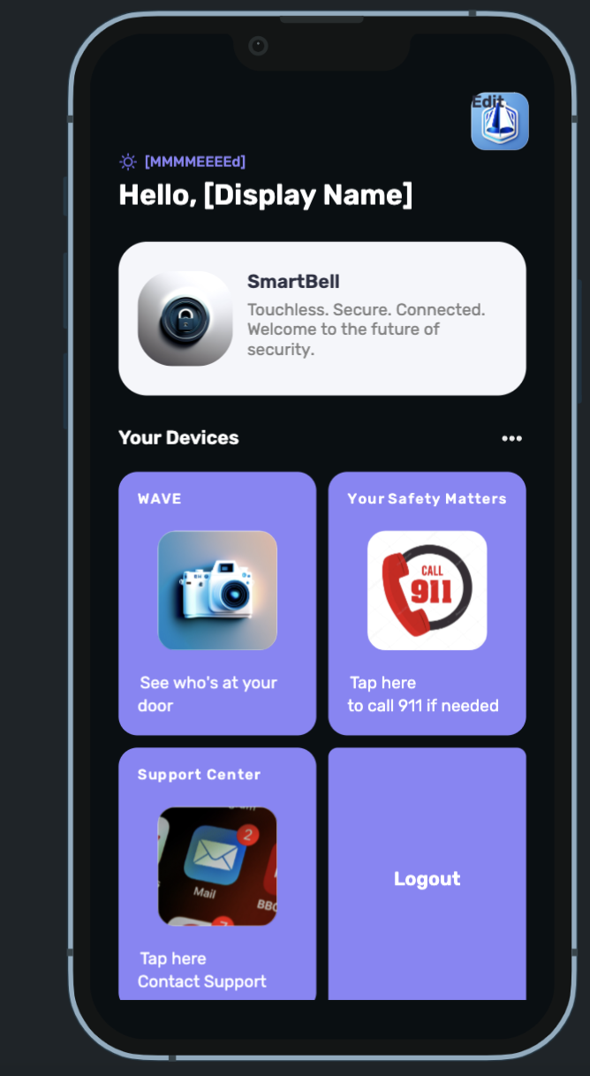
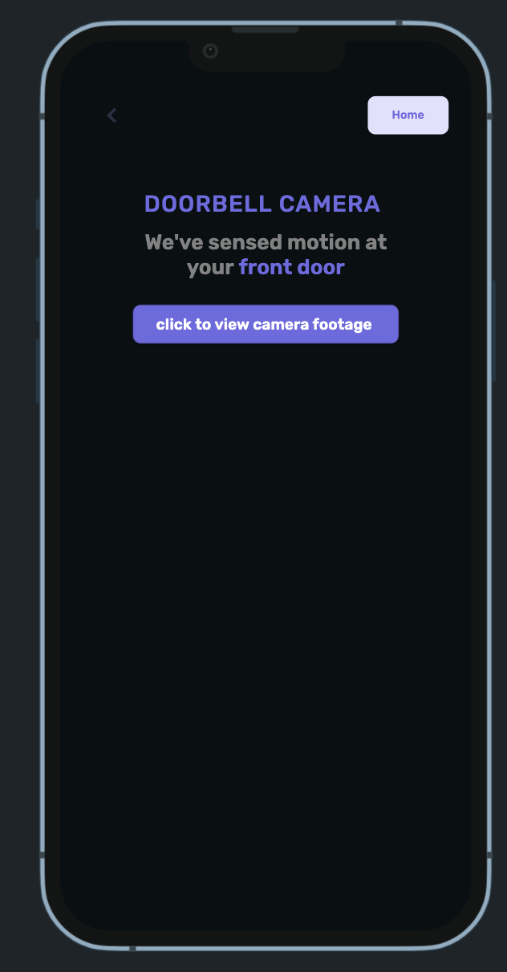
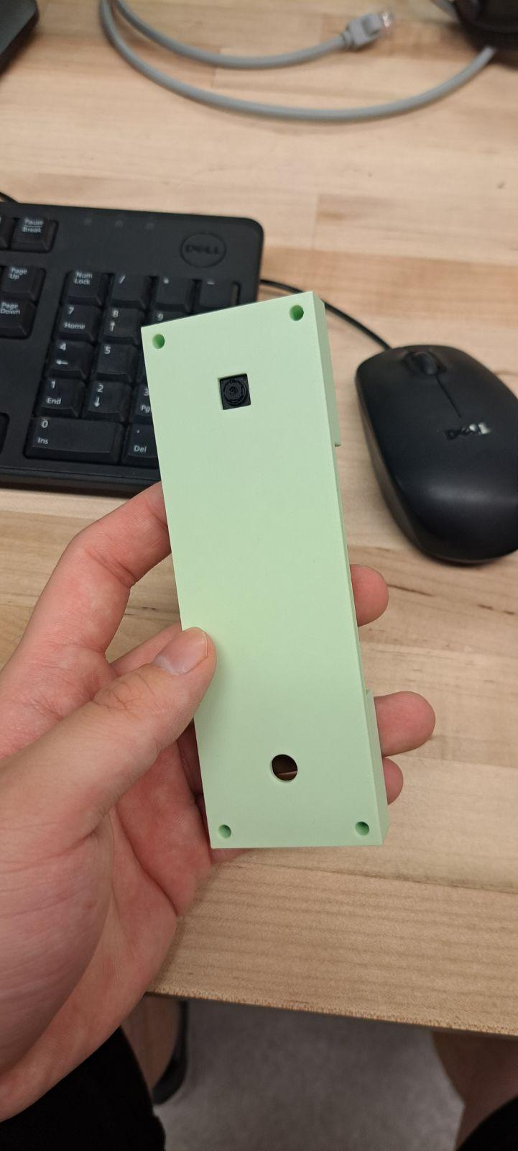
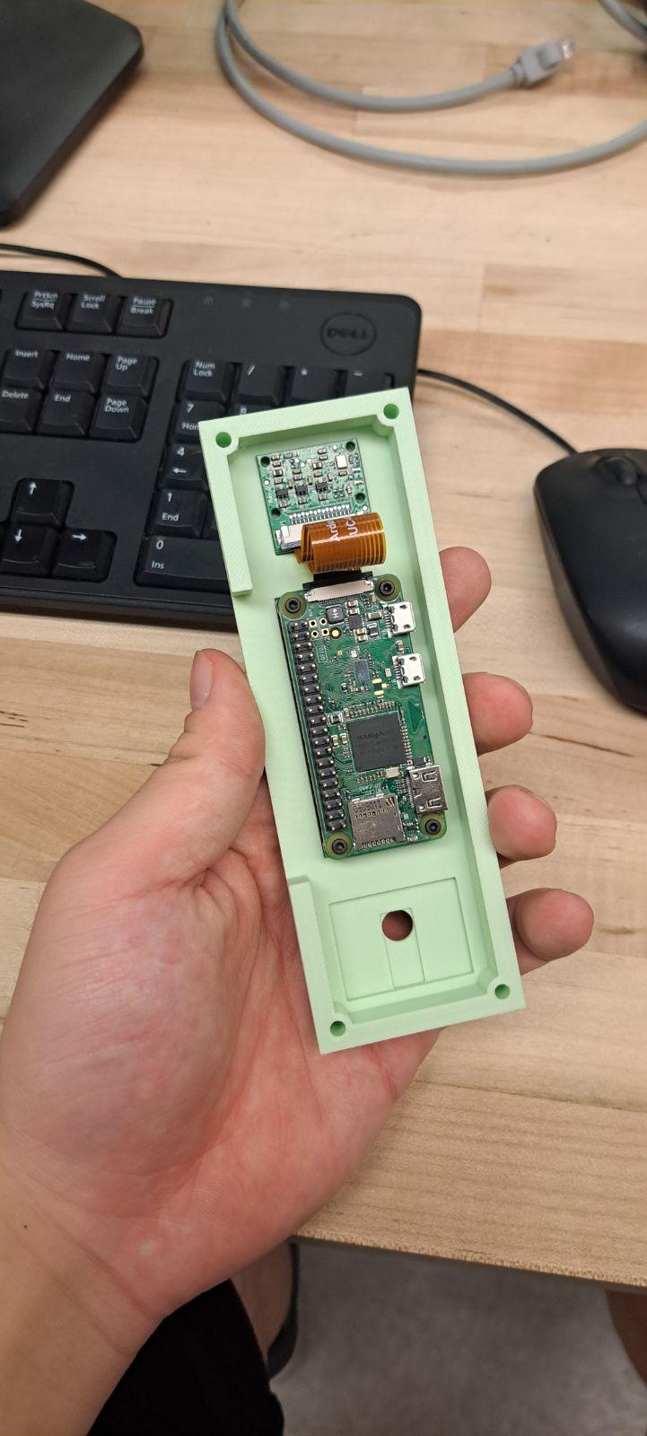
Smart Bell
Michael Boutros, Ian Armada, Shreyas Telkar, Denny Xu, Bharat Mani
Abstract
Overview
Results
With the home security market being limited by so few competitors, the cost for home security devices are not budget friendly
In a digital world, many consumers seek the convenience of enjoying services and products from the comfort of their home
The “Wave” project aims to deliver at home security and home convenience for many homeowners, renters, and businesses at an affordable price point
Through cheap production costs while providing high end Internet of Things (IoT) functionality, SmartBell can provide affordable home security with Wave
SmartBell’s “Wave,” delivers a cost-effective solution for those seeking added home security and home convenience. Designed to cater homeowners, renters, and businesses, wave provides key features such as real-time video monitoring, two-way audio communication, motion detection, an remote access through a mobile application. The product does not only ensure improved security, convenient visitor interactions, and efficient property managements but also brings these benefits at an affordable price point compared to many competitors in the home security market place
Completely functional mobile application that has user-sign in and customization, so that they can access their devices livestream
Functional camera and motion detection sensor that can notify users on the mobile app as well as display real-time video surveillance
Sleek and cheap 3D printed case for easy assembly and mountability
Competitor Comparisons
Description | Wave | Ring
Two-Way Talk | X | X
Livestream | X | X
Video Previews | X | X
Control from mobile App | X | X
Package Alerts | X | X
Motion Detection | X
Price | $69.99 | $249.99
Approach
Split into a Hardware and Software team to devise the workload, following scrum guidelines
Hardware team utilized RaspberryPi 3 for its Wifi capabilities and its ability to program other tools such as cameras, sensors, and speakers
Software team utilized HTML, CSS, JavaScript in creating the website and flutter in creating the app as flutter provided sufficient firebase support
Firebase was used for backend as it worked most effectively with flutter
Tests were ran physically by testing both software and hardware components individually as well as combining both components to see if the components were communicating with each other effectively
Figure 1: Comic showing user’s interaction from door to app
Conclusion
Acknowledgements
SmartBell’s “Wave” will allow many homeowners, renters, and businesses to have access to a more affordable at home security product. Not only does it allow similar, if not better functionality than one of its biggest competitors, the “Ring” Doorbell, but also delivers it at a significantly lower price point. SmartBell hopes to launch its product on its website in the future after further and improved modifications to “Wave”.
University of California, Santa Cruz
Ian Armada Kaaviya Saravanan
Michael Boutros Prakrit Goel
Shreyas Telkar Richard Jullig
Denny Xu
Bharat Mani
Figures 3 & 4: App preview
Figures 5 & 6: Hardware Components

